Slide 1
Open Source Investigation
Tomás Dodds | Leiden

Slide 2
What is Open Source Intelligence?
OSINT is a contested and moving object, but:
Turning non-classified or secret information into actionable insights.
This means that the information is not controlled by a government/company
This means that the information is publicly available

Slide 3
What is Open Source Intelligence?
The information is publicly available:
”Open-source investigation is reporting but using any kind of openly available source. So, think of a Facebook post or a tweet, a YouTube video, or just a database – anything you can find online, openly, and for free”
- Christiaan Tribert, from the Visual Investigations Team, NYT

Slide 4
What is Open Source Intelligence?
OSINT is a contested and moving object, but:
Turning non-classified or secret information into actionable insights.
This means that the information is not controlled by a government/company
This means that the information is publicly available
This means that you can use it to make decisions about something

Slide 5
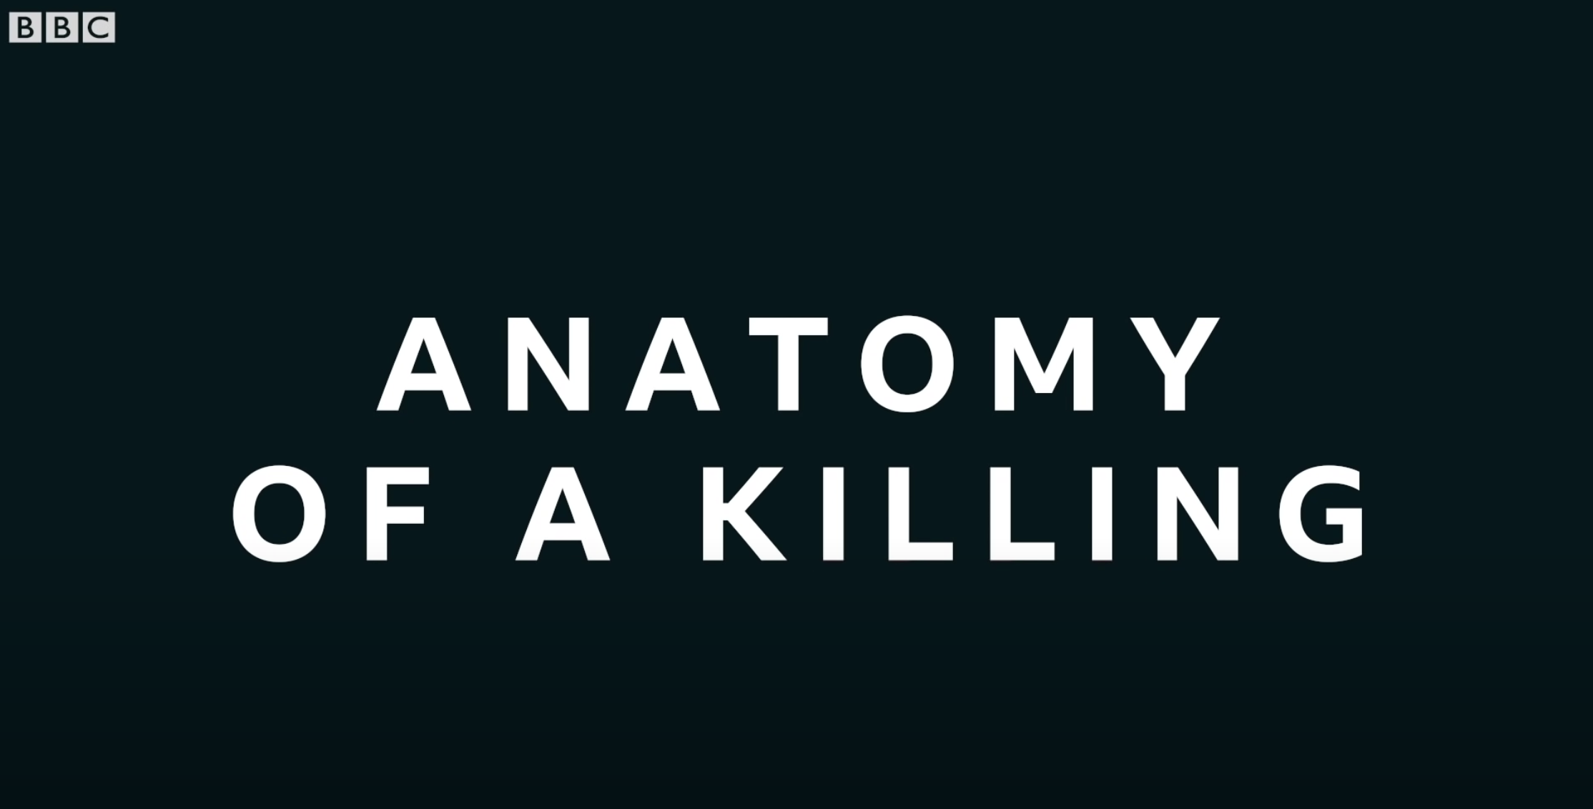
Some examples

Slide 6
For example:
These are things considered sources of OSINT by the European Union:
Public media – print newspapers, magazines, and television.
Internet – online publications and blogs, discussion groups such as forums, and social media websites such as YouTube, Twitter, and Instagram.
Public government data – public government reports, budgets, press conferences, hearings, and speeches.
Professional and academic publications – journals, conferences, academic papers, and theses.
Commercial data – commercial imagery, business and financial assessments, and databases.
Gray literature – technical reports, patents, business documents, unpublished works, and newsletters.

Slide 7
Actionable insights?
Answering the usual W’s (What, When, Who, Where, and HoW) to provide input to someone who can do something about them (hopefully, in the case of civil OSINT)
”Actionable insights or intelligence describes information that has a specific purpose or aims to answer a specific question (strategical level). This commonly requires a deep understanding of the context and the need to combine different information to understand the big picture.”
- CRiTERIA Project

Slide 8
Some examples
The MH17 investigation by Bellingcat

Slide 9
Thinking critically about OSINT
“[N]owadays there is an abundance of documentary evidence that is visual, that you can see for yourself, that you can analyse and connect dots between the different fragments of evidence, and that allows you to reconstruct...a picture of what happened.”
- Malachy Browne, Visual Investigations team, NYT.

Slide 10
Thinking critically about OSINT
Three things to reflect upon:
a) Reflecting upon the role of data: The availability of old and new data types, as well as new and old objects to analyse them.
b) Reflecting upon the role of methodology: New forms of truth production, with its good and bad.
c) Reflecting upon ethics: Journalists turn to OSINT when they do not have on-the-ground access to report directly from the scene of an occurrence.

Slide 11
The role of data (new sources and the pretension of objectivity)
Before:
Under the influence of prominent human rights NGOs, fact-finding became specialized on witness interviewing, often with or through known sources with established credibility.
Early fact-finding involved select diplomats and legal experts conducting field visits and reporting their findings to intergovernmental organizations like the United Nations

Slide 12
The role of data (new sources and the pretension of objectivity)
Now:
The rise of new technologies in human rights fact-finding has allowed for the participation of new actors in the form of civilian witnesses and analysts.
It also requires the participation of others in the form of technologists and machine processes.
These new actors bring with them not only new data and new methods, but also new norms about what human rights knowledge should be.
This democratization demanded the creation of robust and transparent methodologies.

Slide 13
The role of data (new sources and the pretension of objectivity)
A complicated consequence:
Truth is rendered visible as a technological process despite the reporters’ sophisticated approach to and understanding of verification (and OSINT in general) as an interpretative practice.

Slide 14
From Digital Witness (Dubberley 2020)
“Today, data about human rights has become increasingly accessible and is no longer solely the provenance of traditional human rights actors and experts. Advances in digital communication have provided various platforms for the collective development of new techniques to gather, contextualize, and verify data. These changes allow new actors unassociated with traditional human rights organizations, like technologists, volunteer digital verifiers, civilian witnesses, and even algorithms, to participate in the location, interpretation, verification, and promotion of human rights information and offer traditional actors new methods to apply to their work.”

Slide 15
From Digital Witness (Dubberley 2020)
“Thus, both the “who” and the “how” of traditional expertise are shifting: Who, then, are human rights experts today, if human rights information is no longer restricted to experts with relatively exclusive access to sites of struggle? How is information properly contextualized and verified outside of traditional paradigms of known authorship and chains of custody - particularly when there’s so much more information, and so much of it is anonymous or from unknown sources?"

Slide 16
Reflecting upon methods
Point of departure:
Interpretative function is key in the transformation of information into evidence.
“If you can convince people of the authenticity of the footage and your analysis of it, and you’re triple or quadruple corroborating every point you’re making using evidence or testimony, that’s very powerful...It’s transparent, and I think that’s really important in the current climate where trust in media is being eroded.” - Malachy Browne
OSINT legitimizes people’s accounts on the ground. Authenticated data are much harder to discredit than verbal or written eyewitness testimonies.

Slide 17
Reflecting upon methods
Point of departure:
Professionals (journalists, human rights investigators, intelligence gents) have authority based on their experience, proximity to witnesses, understanding of socio-political contexts, methodological expertise, and deep institutional knowledge, including familiarity with advocacy values and practices.
Civilian witnesses have the authority of authenticity and deep cultural, social and historical knowledge.
OSINT investigators invent tools and have the necessary technical expertise to analyze larger bodies of data in new ways.

Slide 18
Reflecting upon methods
Tools are developed by human actors and therefore reflect the biases and limits of their creators. (We need to remain critical to what they show and hide)
However, a techno-romantic view of machines as omniscient – and machine judgement as transparent and uncontaminated by human bias – has often buried this authorship.

Slide 19
From Digital Witness (Dubberley 2020)
“While a focus on methods — particularly reproducible and empiricized methods that can, in theory, be deployed by anyone to verify or challenge human rights stories — can be seen on the one hand as creating new spaces for opportunity, it can be seen on the other as undermining the value of other forms of human judgement, and thereby reducing pluralizing spaces for negotiation and ambiguity.”

Slide 20
The role of ethics
Discussions of verification tend to highlight the technical aspects to build public trust. The precarious newsworkers, activists, bystanders, and victims of violence who risk their lives to provide evidence are often sidelined.
However...
Local knowledge remains the most useful resource for verification.

Slide 21
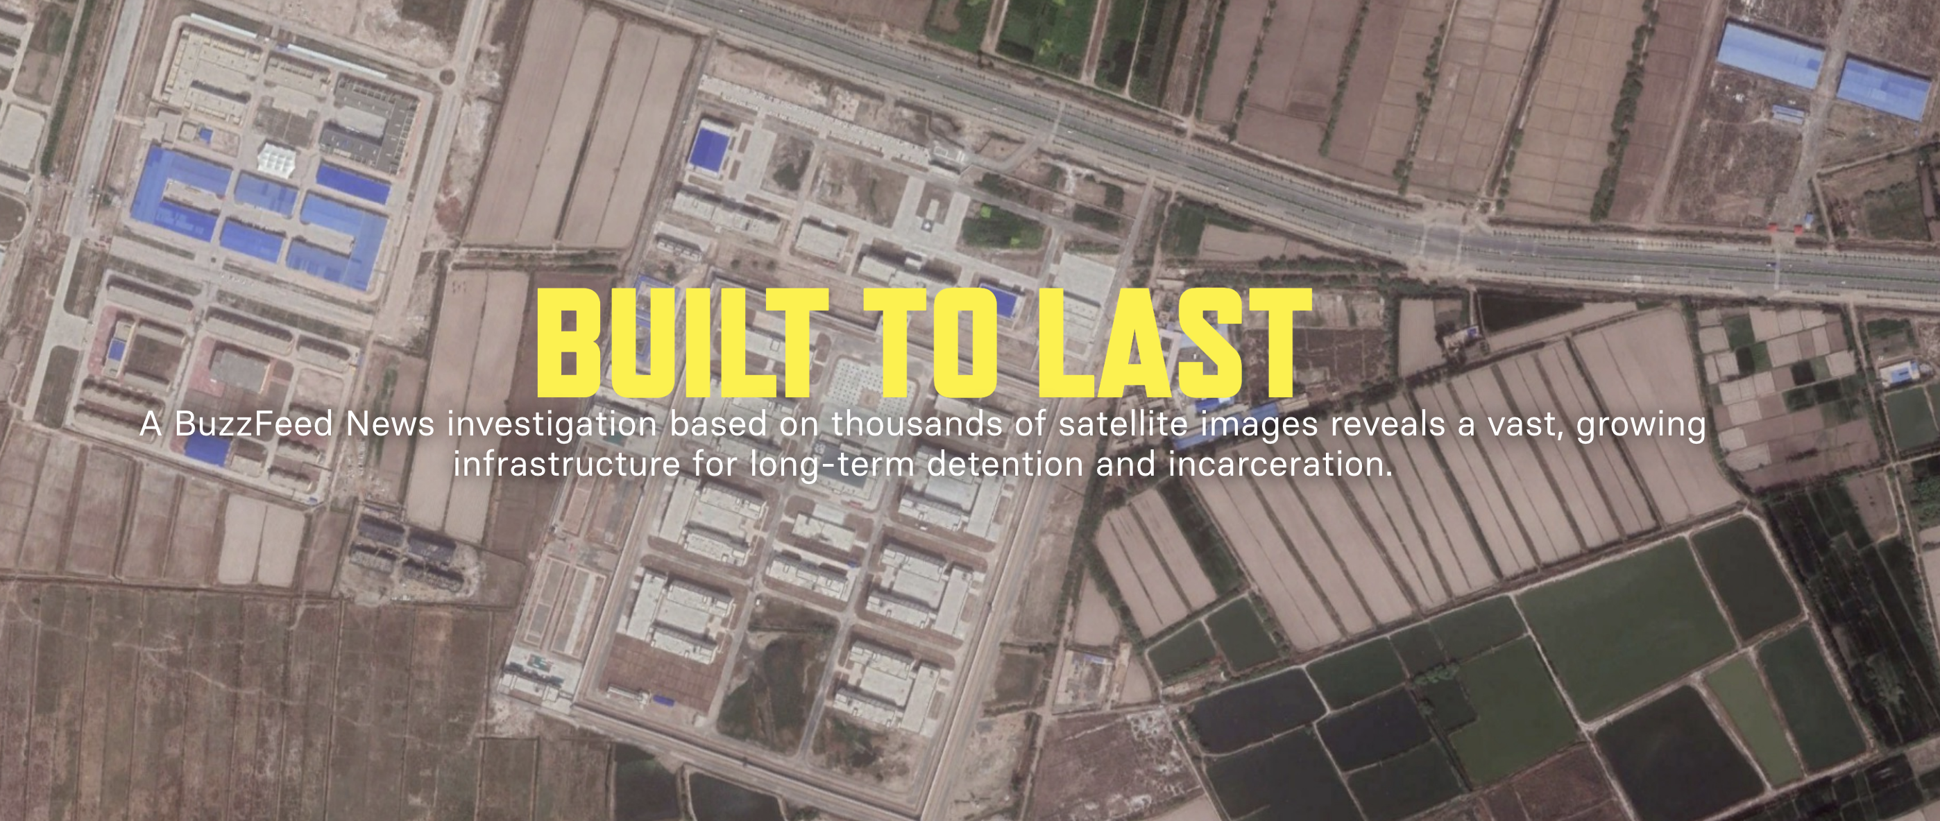
Some examples

Slide 22
Open Source Investigation
Tomás Dodds | Leiden

